Slide 1
Sage ACT! 2011
What’s New?

Slide 2
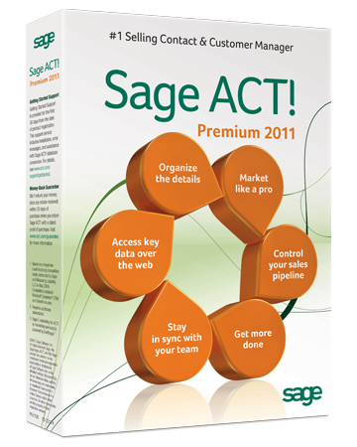
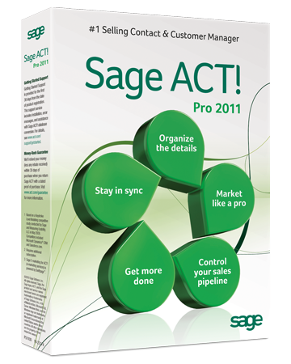
Why Sage ACT! 2011?
Make contact. Build relationships. Get results.
Automate key activities with Smart Tasks
Eliminate double-entry with Sage ACT! and Outlook® sync
Unlock a rich source of new leads with Sage Business Info Services for ACT!—powered by Hoover’sTM

Slide 3
Smart Tasks
Benefit:
Automate key activities with Smart Tasks to help handle everyday details, such as sending emails for you or putting activities on your calendar.
Features:
10 pre-loaded Smart Tasks for common activities with accompanying email marketing templates
Apply right out-of-the-box or simply edit to personalize
Suitable for general productivity or sales efforts
Easy-to-use and intuitive visual designer* lets anyone create or manage Smart Tasks—unlike complicated designers in market
Control the timing, contact lists, and opportunities for each Smart Task
* In the Sage ACT! Premium web client, administrative functions must be performed on the web server.

Slide 4
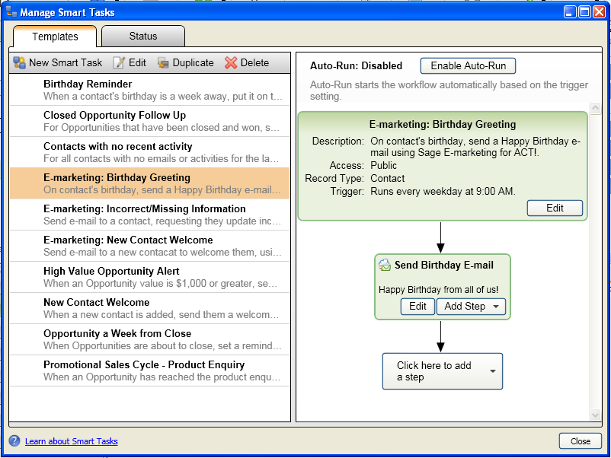
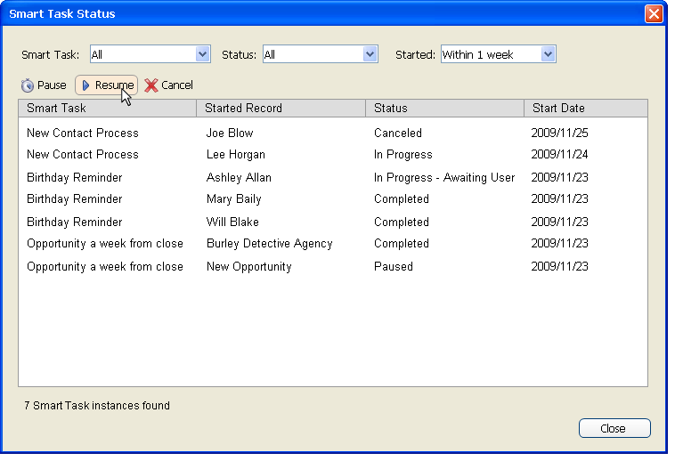
Smart Tasks
Quick reference list of all Smart Tasks available in the database
Smart Tasks are fully integrated with Sage E-marketing for ACT!* so you can send professionally designed emails
Easy to use drag-and-drop visual designer to create or customize multi-step Smart Tasks
Sequence steps based upon the completion of a previous step
Control of and visibility into the status of scheduled Smart Tasks for the current user
* Requires additional subscription.

Slide 5
Customer Feedback
“Smart Tasks--it's a WHOPPER of an idea! I can finally clear out activities from my task list that could be added on a needed basis and help me concentrate on what's most important.”
- Beta Survey Respondent
“Eureka! This functionality [Smart Tasks] is a gem!!! - This step alone will save me hours of time in tracking and performing my updates to a certain group of contacts.”
- Beta Survey Respondent
“Smart Tasks is the most important function; allows for real automation of tasks that save time.”
- Beta Survey Respondent
“They [Smart Tasks] are intuitive and easy to use.”
- Beta Survey Respondent

Slide 6
Outlook Contact and Calendar Sync
Benefit:
Eliminate double entry with integration that allows you to have the best of both worlds. Integrate your Sage ACT! and Outlook contacts, plus keep your calendars in sync.
Features:
Keep existing Sage ACT! contacts in sync with what’s kept in Outlook
Contacts are updated in both places, no matter where changes are made
Control which contacts are synced back and forth
Keep your calendar updated in both places, including rules to automatically handle meeting conflicts
Choose which activity types in Sage ACT! sync back to Outlook

Slide 7
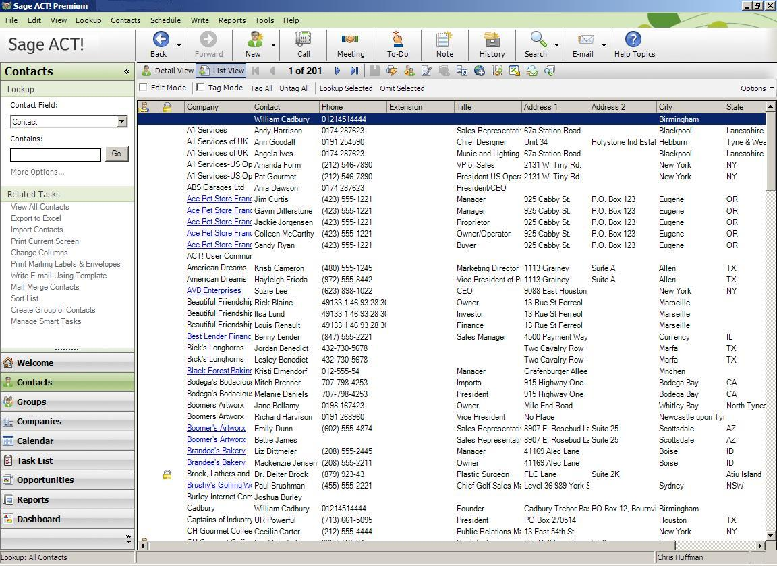
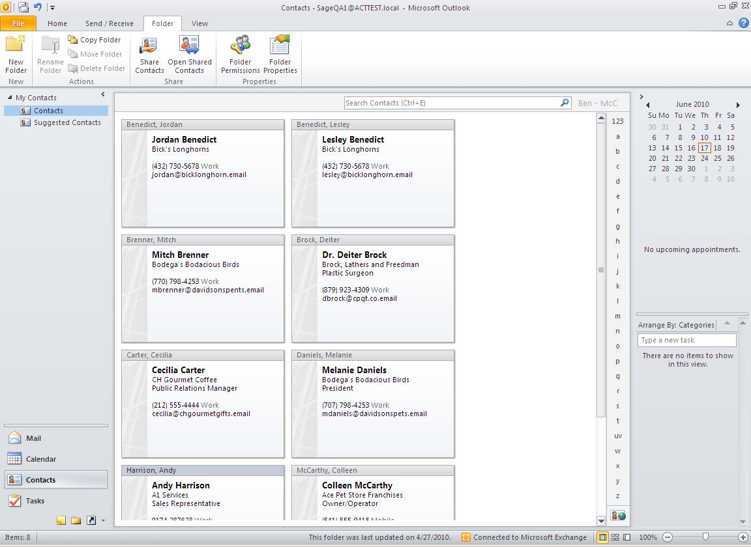
Outlook Contact Sync
Contacts are kept up-to-date, regardless of where they were created or modified
Control which Sage ACT! contacts are synced to Outlook
Create new Outlook contacts from Sage ACT!
Edit Sage ACT! contacts from Outlook

Slide 8
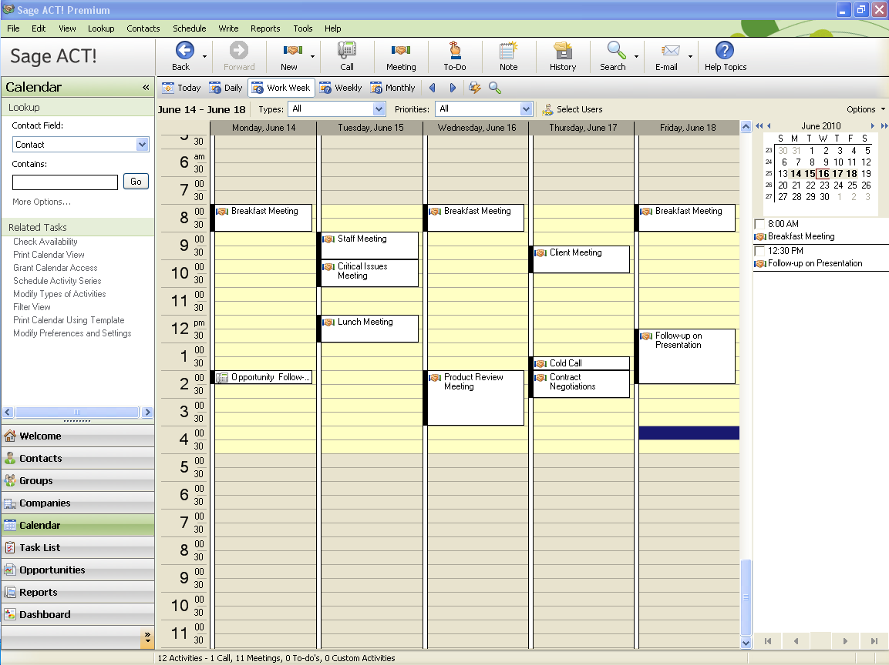
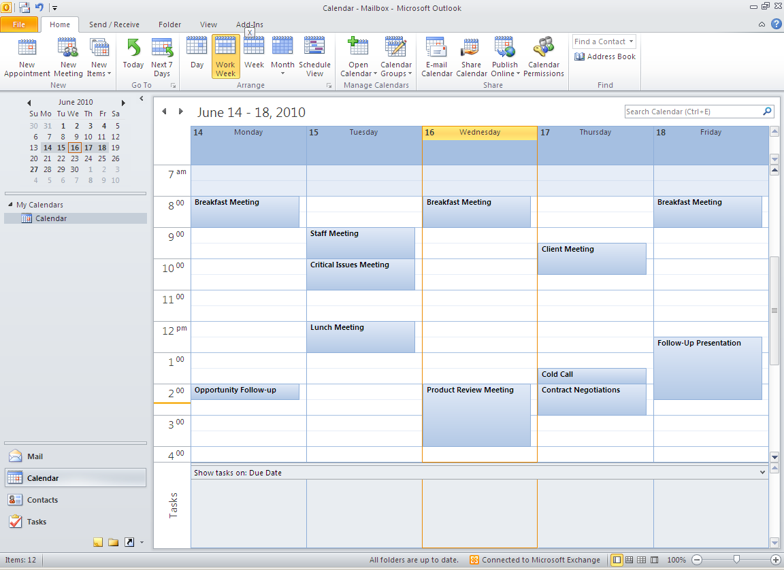
Outlook Calendar Sync
Calendars are kept up-to-date, regardless of where events were created or modified
Choose which system alarms will display in
Auto-sync schedules as frequently as needed
Select which Sage ACT! activity types sync to Outlook

Slide 9
Customer Feedback
“I love the Outlook enhanced syncing capabilities.”
- Beta Survey Respondent
“Very nice to have Outlook contact sync!!”
- Beta Survey Respondent
“Very stable—the Outlook interface works like a charm.”
- Beta Survey Respondent
“Overall was pleased and liked the Outlook integration.”
- Beta Survey Respondent
“I've tried many other brands of contact management and CRM programs and found myself saying ‘If I could only get it to do this, or that.’ Well ACT! does it.”
- Beta Survey Respondent

Slide 10
Sage Business Info Services for ACT!
Benefit:
Unlock a rich source of new leads with Sage Business Info Services for ACT!*, a cloud-based service that pulls highly targeted prospect lists from Hoover’s™ and puts them into Sage ACT!.
Features:
Tap into a database of 65 million companies and 85 million contacts to find new opportunities
Find new leads based on your targeted demographics
View business info about known key contacts and companies including profiles, financials, industry info, news, and more
Receive newsworthy email alerts from a company watch list
Free version includes basic company, financial, and industry info
Subscribe to receive more detailed company, contact, competitive, and lead info
* Requires additional subscription.

Slide 11
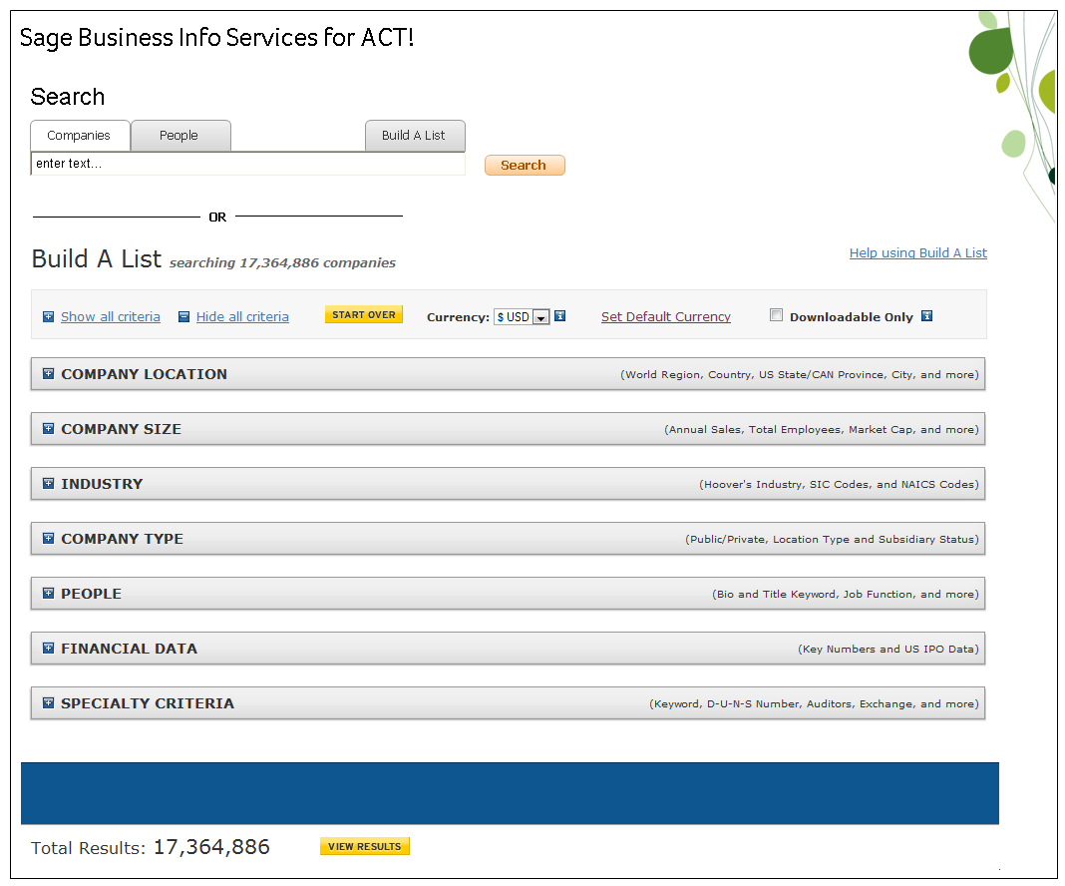
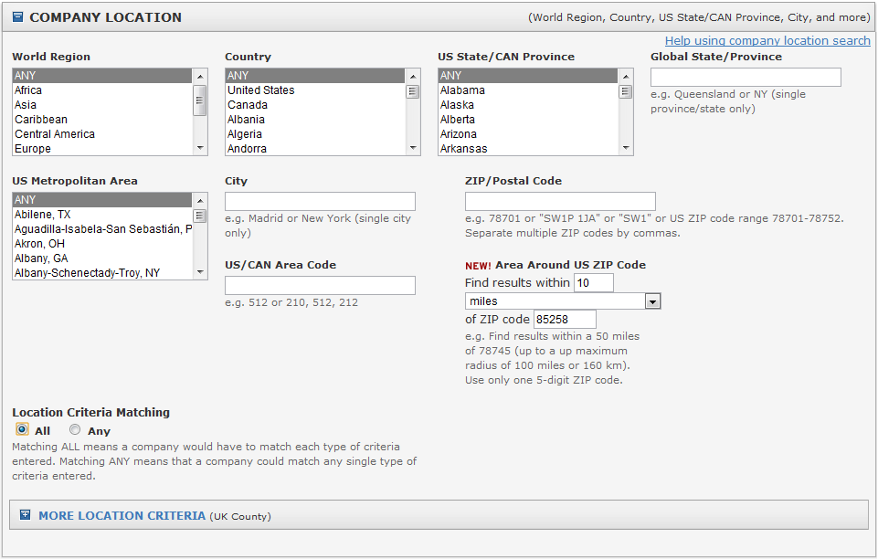
Sage Business Info Services for ACT!
Conduct a keyword search when looking for specific keywords, people, and companies*
Build a list in just a few steps using 40+ search criteria*
Refine your search based on targeted demographics*
* Available on Reference + Leads plans only.

Slide 12
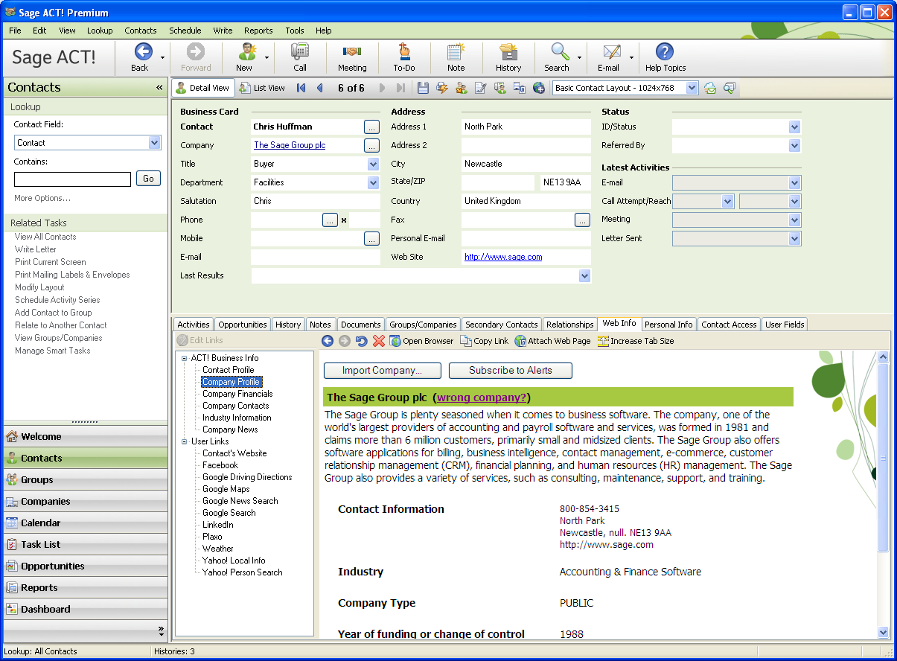
Sage Business Info Services for ACT!
Import company info including the company's history and overview, products and operations, competitors, and key financial data*
Receive a summary news report via email on the companies you’re following *
View breaking news from a variety of sources that appear in a timeline format for easy viewing*
* Some information may be only available on Reference and Reference + Leads plans only.

Slide 13
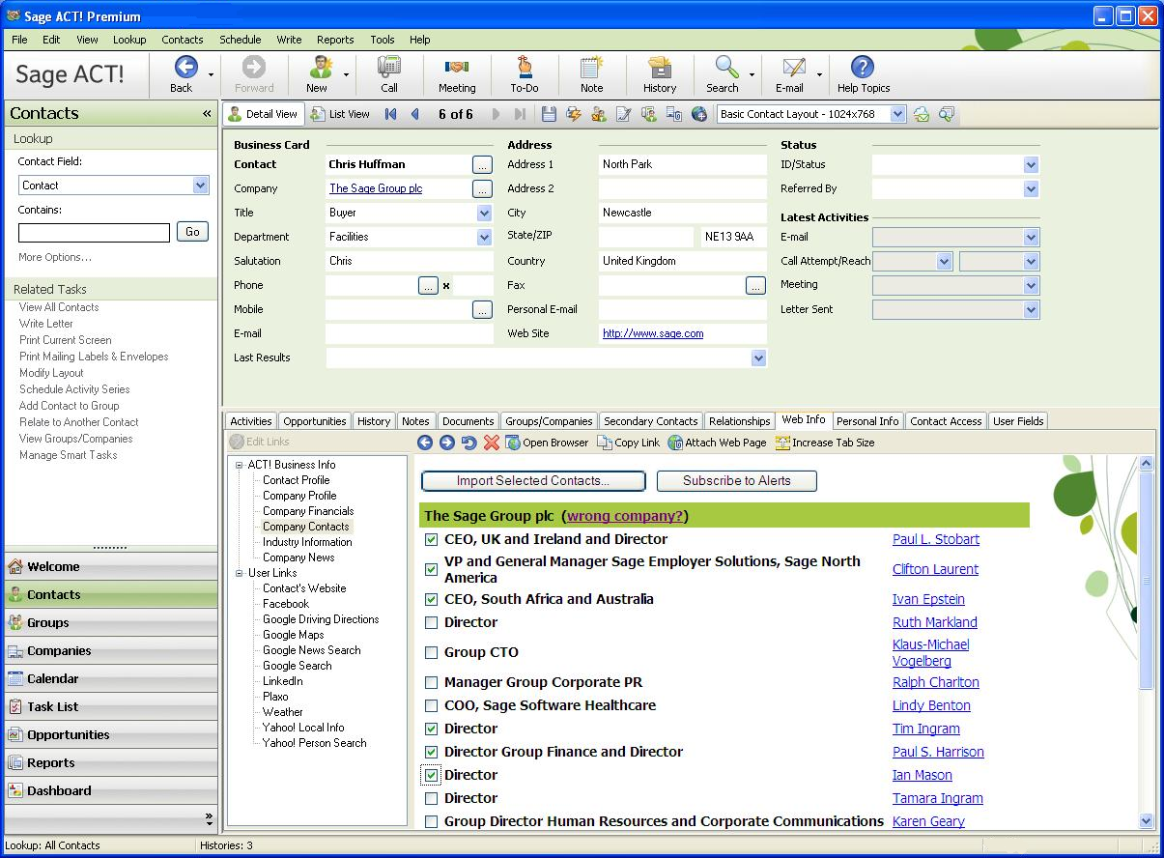
Sage Business Info Services for ACT!
Import selected contacts and their info into your Sage ACT! database**
Target key decision makers within a company by viewing a listing of their names and titles*
Click on contact names for more detail such as their biography and job history**
* Some information may be only available on Reference and Reference + Leads plans only.
** Contact data is variable based on the data collected by Hoover’s.

Slide 14
Compare Business Info and Leads Plans
Most popular!
 |  |  | Reference + Leads $54.95 pupm | Reference $24.95 pupm | Free Business Directory
Business Info
 | Profile | Line of Business
 |  | Full Description
 | Financials | Basic
 |  | Expanded
 | Contacts | Import Key People
 | Industry | Overview
 |  | Competitors – Top 3
 |  | Competitors – Full List
 | News | News and Timeline
 | Alerts | Email Alerts
Leads
 |  | 400 Leads per Month*
 |  | Keyword Search
 |  | Build a List
Need more? *Additional leads sold in blocks of 400 for $49.95/month.

Slide 15
Why Sage ACT! 2011?
Make contact. Build relationships. Get results.
Automate key activities with Smart Tasks
Eliminate double-entry with Sage ACT! and Outlook® sync
Unlock a rich source of new leads with Sage Business Info Services for ACT!—powered by Hoover’sTM

Slide 16
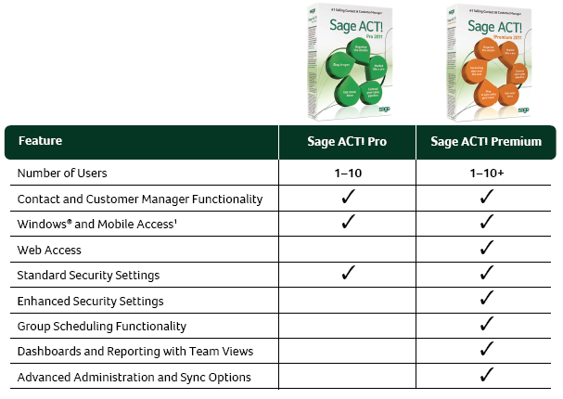
Product Comparisons
1 Requires additional subscription to ACT! Mobile Live.

Slide 17
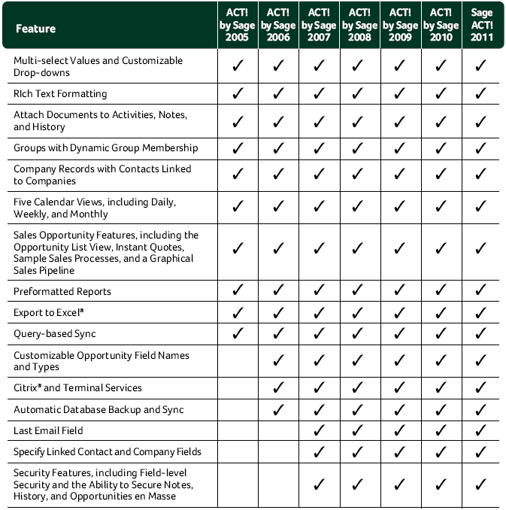
Version Comparisons

Slide 18
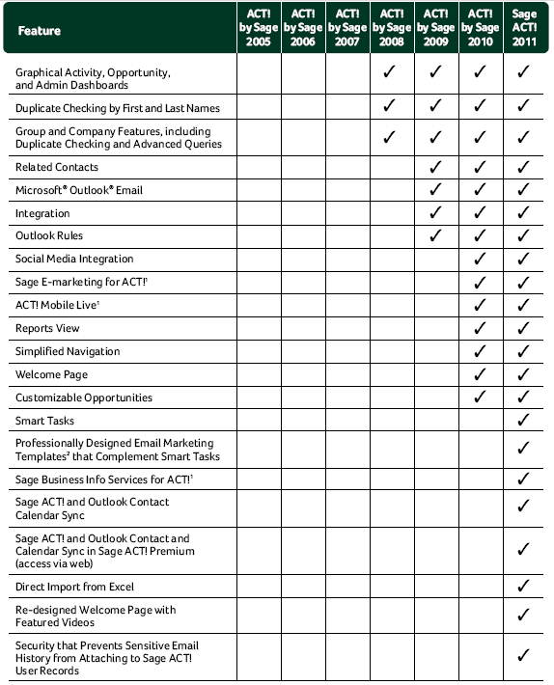
1 Requires additional subscription.
2 Requires subscription to Sage E-marketing for ACT!.

Slide 19
Click here to learn more and get started with Sage ACT! 2011

